Slide 1



Development of the I.M.O Shadow Portal
For: DGMA Shipping
August 2026

Slide 2
Table of Contents
Section
A. Workflow Overview
B. Modules
Module 1: User Management and Role Based Access Control
Module 2 - Committee, Sub-Committee & Meeting Management​
Module 3 - Agenda, Group & Correspondence Group Management​
Module 4 - Task Management System​
Module 5 - Document Repository & Paper Preparation​
Module 6 - Feedback, Review & Consolidation​
Module 7 - Real-Time Collaboration Tools​
Module 8 - Reporting, Monitoring & Analytics
Module 9 - “Others+” International Engagements Module​
C. India Representation at IMO
D. User Roles and Access Management
E. Access Rights Matrix
F. Roles and Permission Matrix
G. Calendar

Slide 3
A. Workflow Overview

Slide 4
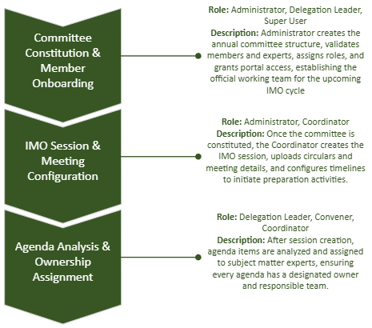
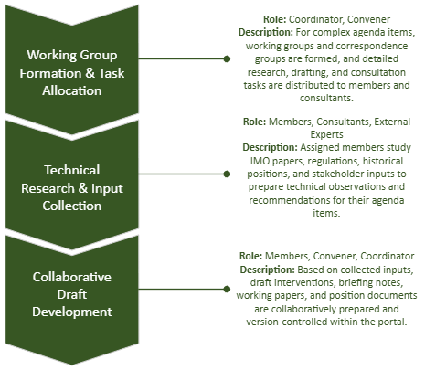
Workflow Overview

Slide 5
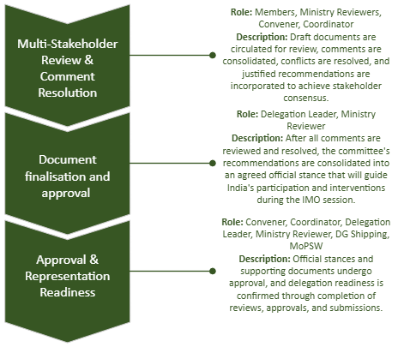
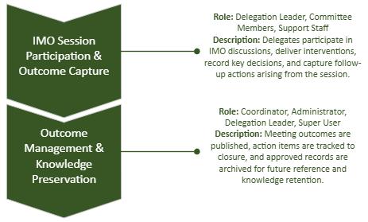
Workflow Overview
1
1

Slide 6
B. Modules

Slide 7
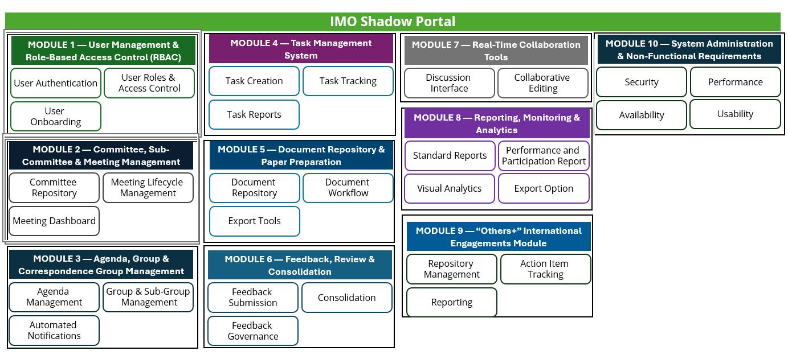
Modules

Slide 8
Module 1 - User Management and Role Based Access Control

Slide 9
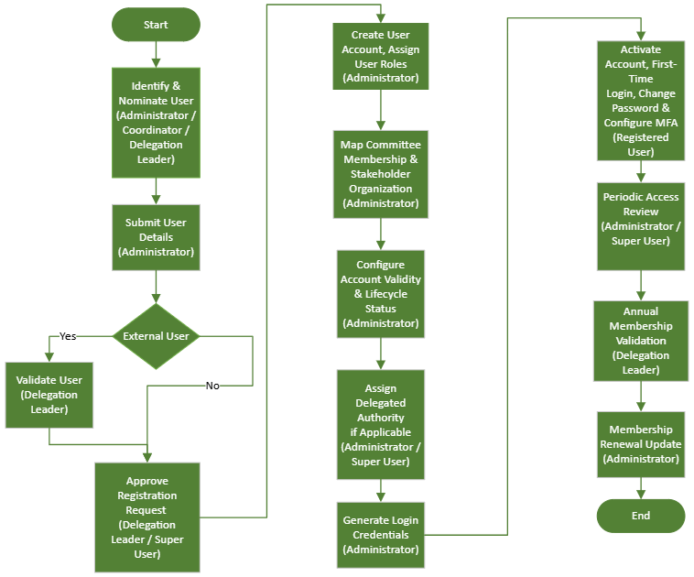
1.1 User Management and Role Based Access Control

Slide 10
Module 2 - Committee, Sub-Committee & Meeting Management​

Slide 11
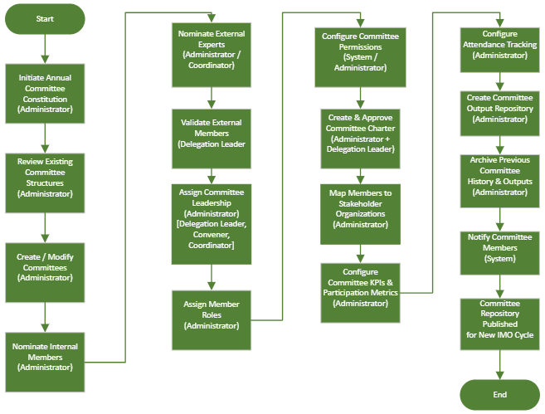

2.1. Annual Committee Constitution Workflow

Slide 12
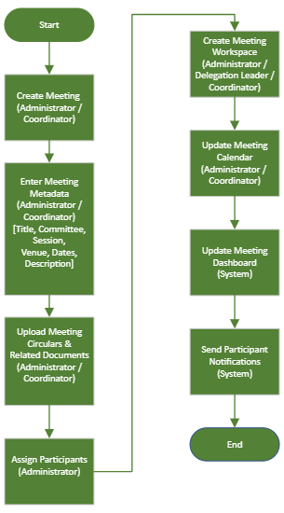
2.2. Meeting Creation Workflow

Slide 13
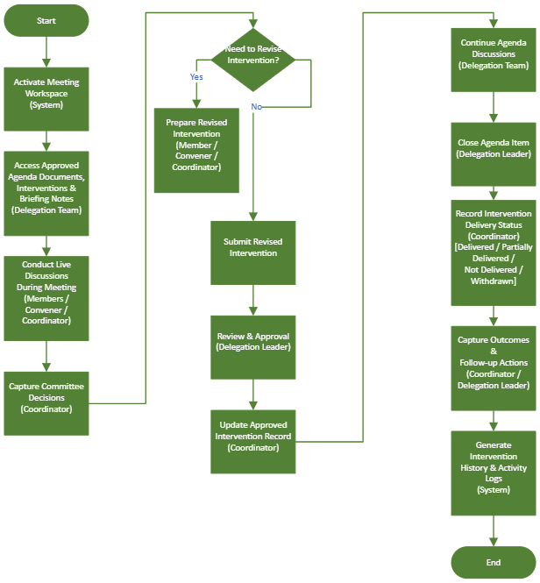
2.3. Meeting Execution Workflow

Slide 14
Module 3 - Agenda, Group & Correspondence Group Management​

Slide 15
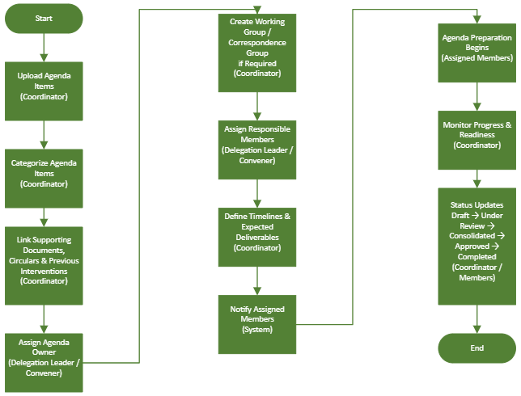
3.1. Agenda Assignment Workflow

Slide 16
Module 4 - Task Management System​

Slide 17
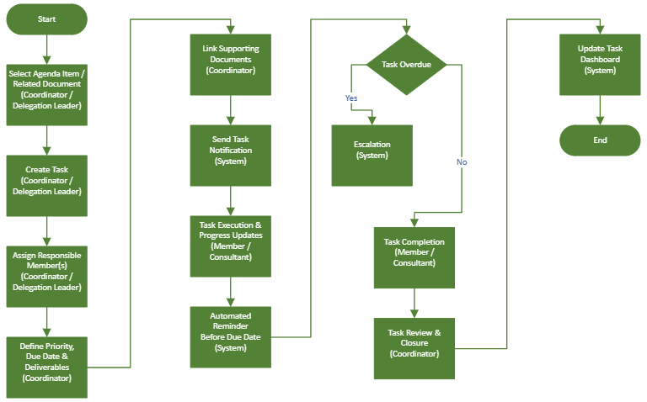
4.1. Task Assignment Workflow

Slide 18
Module 5 - Document Repository & Paper Preparation​

Slide 19
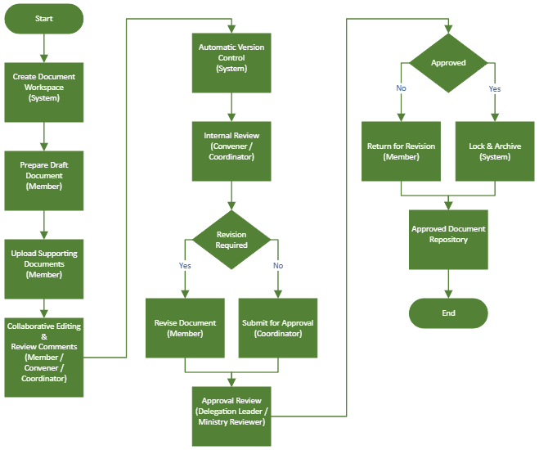
5.1. Document Preparation and Deliberation Workflow

Slide 20
Module 6 - Feedback, Review & Consolidation​

Slide 21
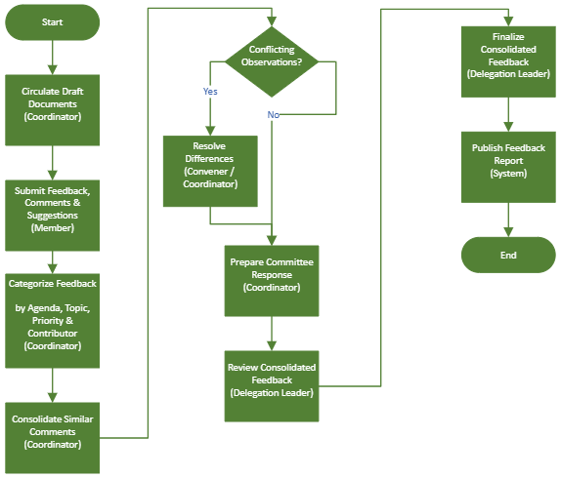
6.1. Feedback Consolidation Workflow

Slide 22
Module 7 - Real-Time Collaboration Tools​

Slide 23
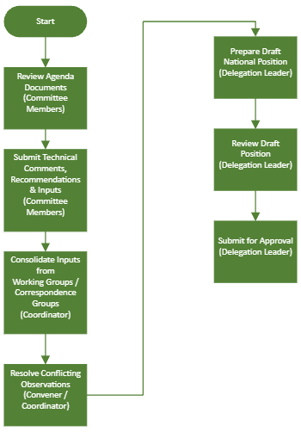
7.1. Real-time Collaboration

Slide 24
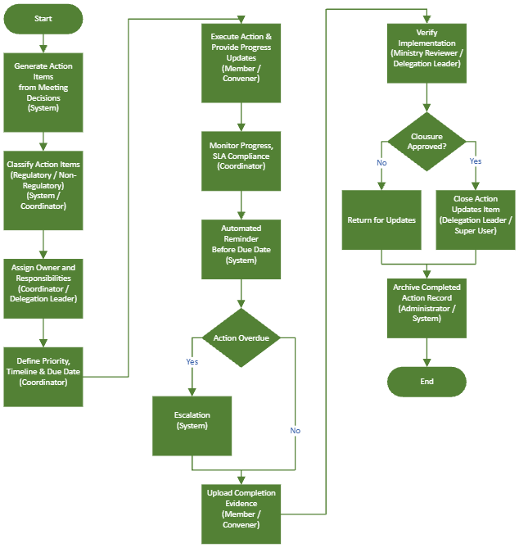
7.2. Action Item Workflow

Slide 25
Module 8 - Reporting, Monitoring & Analytics​

Slide 26
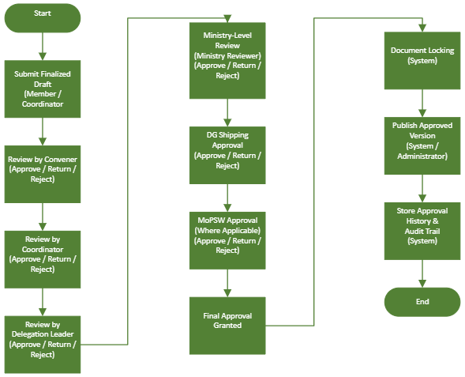
8.1. Approval Workflow
(In case of exception)

Slide 27
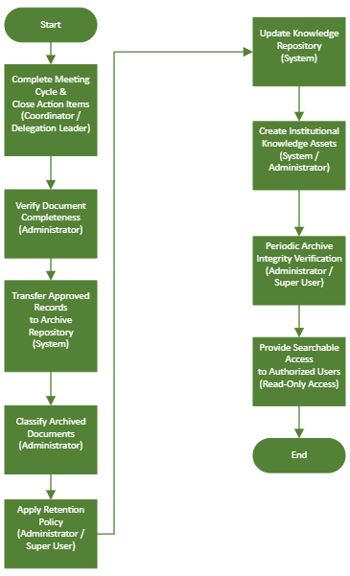
8.2. Archival Workflow

Slide 28
Module 9 - “Others+” International Engagements Module​

Slide 29
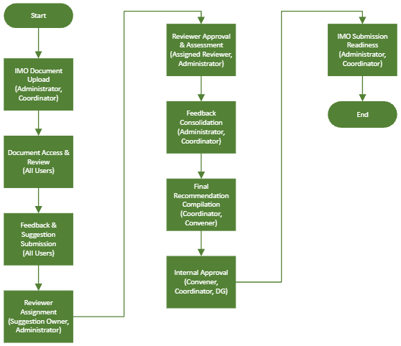
9.1. IMO Document Review & Submission Workflow

Slide 30
C. India Representation at IMO

Slide 31
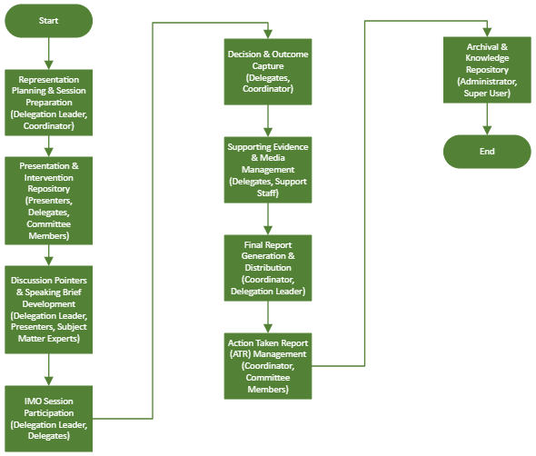
India Representation at IMO

Slide 32
D. User Roles and Access Management

Slide 33
Access Control
Key Responsibilities
Full access across all modules and system configuration.
Manage system governance, user roles, access permissions, delegated authority, and stakeholder registry.
Configure workflows, metadata standards, document classification schemes, retention policies, and organizational controls.
Monitor portal performance, compliance, operational metrics, and generate system-wide reports and dashboards.
Super User
Full operational management with limited system configuration rights.
Manage users, committees, meetings, and stakeholder organizations.
Administer agenda items, documents, tasks, notifications, and committee charters.
Monitor attendance, workflow progress, and committee performance.
Administrator
Review, approval, monitoring, and delegation-level oversight access.
Review consolidated feedback and monitor committee readiness.
Approve draft documents, interventions, and external expert participation.
Validate committee memberships and provide final submission recommendations.
Delegation
Leader
Manage assigned committees, agendas, tasks, submissions, and collaboration workspaces.
Manage committees, working groups, and correspondence groups.
Coordinate agenda assignments, task allocation, and feedback consolidation.
Track submissions, monitor readiness, and oversee regulatory follow-up actions.
Coordinator

Slide 34
Access Control
Key Responsibilities
Technical review, recommendation, participation, and limited task assignment access.
Lead committee discussions and stakeholder coordination.
Review submissions and validate technical inputs.
Manage issue registers and support position finalization.
Convener
Member
Access limited to assigned committees, documents, tasks, and discussion spaces.
Review assigned agenda items and reference documents.
Prepare comments, participate in discussions, and complete assigned tasks.
Submit feedback, interventions, and correspondence group contributions.
Assigned access only; no approval or administrative authority.
Provide research, documentation, and drafting support.
Upload supporting materials and generate reports.
Assist in activity monitoring and administrative coordination.
Consultant
Review and comment access only; no administrative or configuration privileges.
Review agenda papers, interventions, and policy documents.
Assess regulatory implications and policy alignment.
Provide comments and recommendations on submissions.
Ministry
Reviewer

Slide 35
E. Access Rights Matrix

Slide 36
Access Rights Matrix
Module | Super User | Administrator | Delegation Leader | Coordinator | Convener | Member | Consultant | Ministry Reviewer
Dashboard | Full | Full | Assigned | Assigned | Assigned | Personal | Assigned | Review
User Management | Full | Manage | View | View | No | No | No | No
Committee Management | Full | Full | View | Manage Assigned | View | View | View | View
Meeting Management | Full | Full | View | Manage | View | View | View | View
Agenda Management | Full | Full | Review | Manage | Manage | View | View | Review
Document Repository | Full | Full | Review | Upload/Manage | Upload | View | Upload | Review
Task Management | Full | Full | Monitor | Assign | Assign | Update Own | Update Assigned | View
Feedback Management | Full | Full | Consolidate | Consolidate | Review | Submit | Submit | Review
Approval Workflow | Full | Manage | Approve | Recommend | Recommend | No | No | Review
Reports & Analytics | Full | Full | Assigned | Assigned | Assigned | Personal | Assigned | Review
System Configuration | Full | Limited | No | No | No | No | No | No

Slide 37
Module | Super User | Administrator | Delegation Leader | Coordinator | Convener | Member | Consultant | Ministry Reviewer
Stakeholder Organization Registry | Full | Manage | View | View | View | No | View | View
Committee Charter Repository | Full | Manage | Review | Manage | View | View | View | Review
Committee Performance Dashboard | Full | Full | Monitor | Monitor | View | Personal | View | Review
Attendance & Participation Management | Full | Manage | Monitor | Manage | View | View Own | View | Review
Committee Output Repository | Full | Manage | Review | Upload/Manage | Upload | View | Upload | Review
Correspondence Workspace | Full | Manage | Monitor | Manage | Participate | Participate | Participate | View
Submission Tracker | Full | Manage | Monitor | Manage | View | View Assigned | View Assigned | Review
Regulatory Follow-Up Tracking | Full | Manage | Monitor | Monitor | Update | Update Assigned | Update Assigned | Review
Readiness Dashboard | Full | Full | Full | Monitor | View | Personal | View | Review

Slide 38
F. Roles and Permission Matrix

Slide 39
Roles and Permission Matrix
Permission | Super User | Admin | Leader | Coordinator | Convener | Member | Consultant | Ministry Reviewer
Create | ✓ | ✓ | Limited | ✓ | Limited | ✗ | Limited | ✗
View | ✓ | ✓ | ✓ | ✓ | ✓ | ✓ | ✓ | ✓
Edit | ✓ | ✓ | Limited | ✓ | Limited | Own | Assigned | Comment
 |  |  |  |  |  |  |  | Only
Delete | ✓ | ✓ | ✗ | Limited | ✗ | ✗ | ✗ | ✗
Approve | ✓ | Limited | ✓ | Recommend | Recommend | ✗ | ✗ | Review
Assign Tasks | ✓ | ✓ | ✓ | ✓ | Limited | ✗ | ✗ | ✗
Generate Reports | ✓ | ✓ | ✓ | Assigned | Assigned | Personal | Assigned | Review
Configure System | ✓ | Limited | ✗ | ✗ | ✗ | ✗ | ✗ | ✗
Manage Committee Membership | ✓ | ✓ | Approve | Update | Recommend | ✗ | ✗ | ✗
Approve External Experts | ✓ | Process | ✓ | Recommend | Recommend | ✗ | ✗ | ✗
Delegate Approval Authority | ✓ | Configure | ✓ | Recommend | ✗ | ✗ | ✗ | ✗

Slide 40
Permission | Super User | Admin | Leader | Coordinator | Convener | Member | Consultant | Ministry Reviewer
Manage Stakeholder Organizations | ✓ | ✓ | View | View | ✗ | ✗ | ✗ | ✗
Manage Correspondence Workspaces | ✓ | ✓ | Monitor | ✓ | Participate | Participate | Participate | ✗
Monitor Readiness Dashboard | ✓ | ✓ | ✓ | ✓ | View | Personal | View | Review
Track Regulatory Follow-up | ✓ | ✓ | ✓ | ✓ | Update | Update Own | Update Assigned | Review
Manage Committee Charter | ✓ | ✓ | Approve | Edit | Review | View | View | Review

Slide 41
G. Calendar

Slide 42
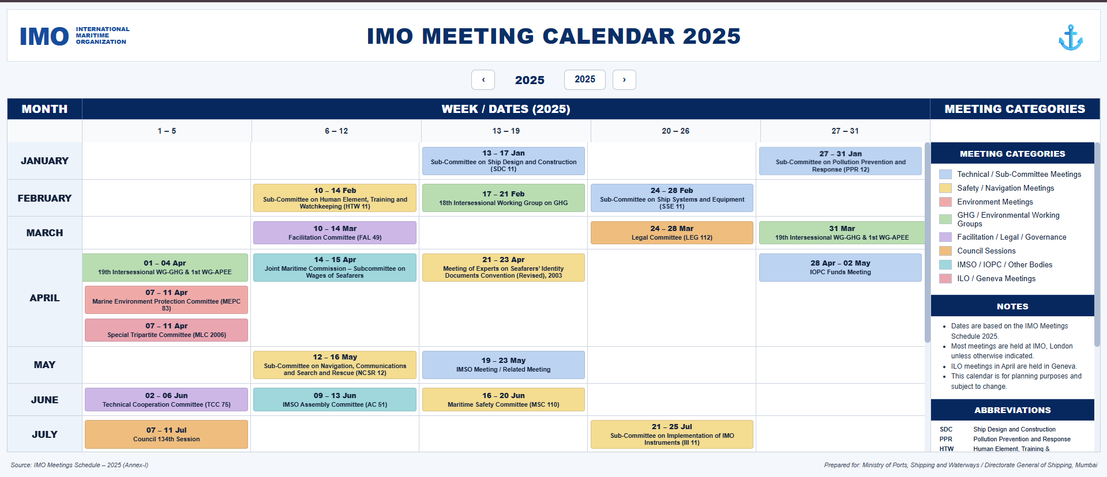

Slide 43
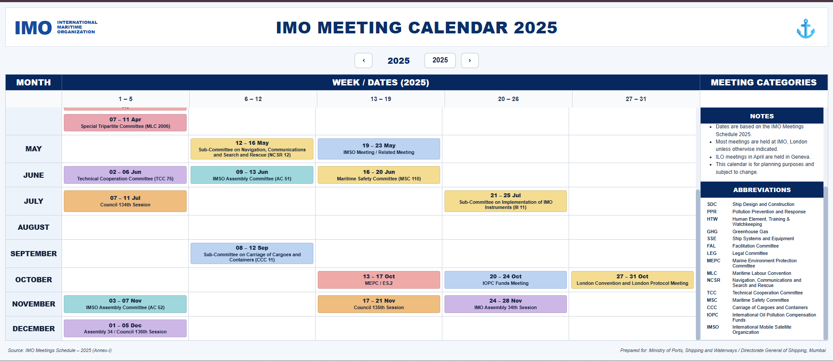

Slide 44
Deloitte refers to one or more of Deloitte Touche Tohmatsu Limited, a UK private company limited by guarantee (“DTTL”), its network of member firms, and their related entities. DTTL and each of its member firms are legally separate and independent entities. DTTL (also referred to as “Deloitte Global”) does not provide services to clients. Please see www.deloitte.com/about for a more detailed description of DTTL and its member firms.
This material is prepared by Deloitte Touche Tohmatsu India LLP (DTTILLP). This material (including any information contained in it) is intended to provide general information on a particular subject(s) and is not an exhaustive treatment of such subject(s) or a substitute to obtaining professional services or advice. This material may contain information sourced from publicly available information or other third party sources. DTTILLP does not independently verify any such sources and is not responsible for any loss whatsoever caused due to reliance placed on information sourced from such sources. None of DTTILLP, Deloitte Touche Tohmatsu Limited, its member firms, or their related entities (collectively, the “Deloitte Network”) is, by means of this material, rendering any kind of investment, legal or other professional advice or services. You should seek specific advice of the relevant professional(s) for these kind of services. This material or information is not intended to be relied upon as the sole basis for any decision which may affect you or your business. Before making any decision or taking any action that might affect your personal finances or business, you should consult a qualified professional adviser.
No entity in the Deloitte Network shall be responsible for any loss whatsoever sustained by any person or entity by reason of access to, use of or reliance on, this material. By using this material or any information contained in it, the user accepts this entire notice and terms of use.
© 2026 Deloitte Touche Tohmatsu India LLP. Member of Deloitte Touche Tohmatsu Limited

